Slide 1


Document Sharing Overview
John Moehrke
Co-Chair ITI Planning
By Light Professional IT Services LLC

Slide 2
























IHE Standards-based HIE (XDS) Key Components
Patient ID Manager
PRIMARY CARE PHYSICIANS
Practice Management
EMR
PATIENT
Personal Health Records
Document Registry
Document Repositories
LAB
Results
PUBLIC HEALTH
Registries
PAYERS
Claim Data
HOSPITAL 2
EMR/PM’s
Lab
PACS Archive
PHARMACY/PBMs
RX History
SPECIALTY PRACTICE
Practice Management
EMR
HOSPITAL 1
EMR/PM’s
Lab
PACS Archive
Notes:
See http://healthcaresecprivacy.blogspot.com/p/topics.html#HIE

Slide 3

IHE Standards-based HIE (XCA) Community Document Sharing
XCA Gateway
Patient ID Manager
PRIMARY CARE PHYSICIANS
Practice Management
EMR
Patient ID Manager
PRIMARY CARE PHYSICIANS
Practice Management
EMR
Document Registry
PATIENT
Personal Health Records
Document Registry
PATIENT
Personal Health Records
Document Repositories
Document Repositories
LAB
Results
LAB
Results
PUBLIC HEALTH
Registries
PAYERS
Claim Data
PUBLIC HEALTH
Registries
PAYERS
Claim Data
EHR
PHARMACY/PBMs
RX History
HOSPITAL 2
EMR/PM’s
Lab
PACS Archive
PHARMACY/PBMs
RX History
HOSPITAL 2
EMR/PM’s
Lab
PACS Archive
SPECIALTY PRACTICE
Practice Management
EMR
HOSPITAL 1
EMR/PM’s
Lab
PACS Archive
SPECIALTY PRACTICE
Practice Management
EMR
HOSPITAL 1
EMR/PM’s
Lab
PACS Archive
Notes:
See http://healthcaresecprivacy.blogspot.com/p/topics.html#HIE

Slide 4
Principles of a Document
Persistence – A Document continues to exist in an unaltered state, for a time period defined by local and regulatory requirements. Note documents outlive the servers (and often the syntax), on which they are created.
Stewardship –A document is maintained over its lifetime by a custodian, either an organization or a person entrusted with its care.
Authenticatable -- Potential for authentication - A clinical document is an assemblage of information that is intended to be legally authenticated.
Context - A clinical document establishes the default context for its contents
Wholeness - A document is a whole unit of information. Parts of the document may be created or edited separately, or may also be authenticated or legally authenticated, but the entire document is still to be treated as a whole unit.
Human readability – a document is human readable
Notes:
See https://healthcaresecprivacy.blogspot.com/2013/11/distinction-between-documents-and.html
True of both CDA documents and FHIR documents

Slide 5
Various Formats and Encodings
XDS/XCA are content agnostic
Metadata enable discovery
CDA, C-CDA, C32, etc
FHIR Documents
DICOM Documents
PDF/Text
Graphics (JPEG, MPEG, TIFF…)
Special (On-Demand, Delayed)
EMR
CCDA
2.1
CCDA
1.1
C32
PDF
FHIR
Notes:
See https://healthcaresecprivacy.blogspot.com/2015/10/ihe-formatcodes-are-mandatory.html

Slide 6
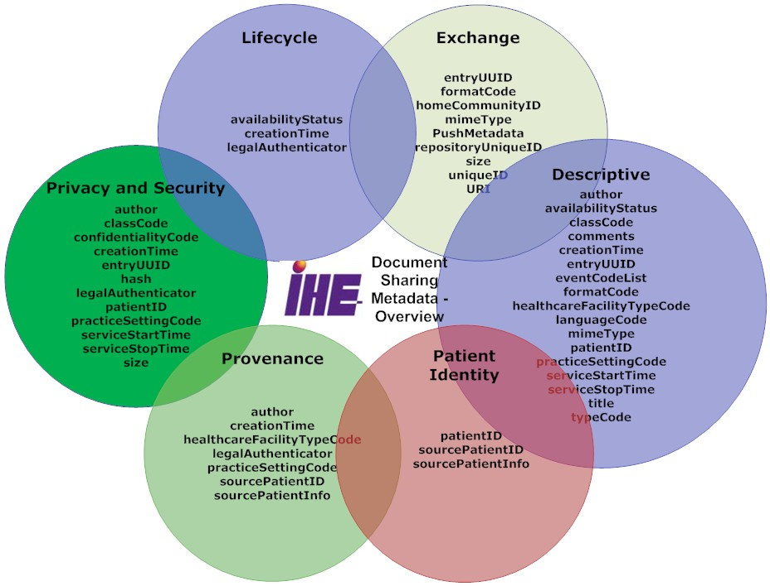
Metadata – enables discovery

Slide 7
Supporting Infrastructure
Security & Privacy -- https://wiki.ihe.net/index.php/Category:Security
ATNA, XUA, CT, SeR,
DSG, DEN
BPPC, APPC
Patient Identity
PDQ, PIX, PAM
XCPD
Provider Identity
HPD, CSD, PWP
Workflow
XDW

Slide 8
More detail
https://wiki.ihe.net/index.php/Category:DocShare
WhitePaper – Document Sharing using IHE Profiles
Handbook – Document Sharing Metadata Handbook (NEW)
Handbook – Template for XDS Affinity Domain Deployment Planning
IHE Format Codes
Transport Profiles – XDS, XCA, XDR, XDM, MHD, DSUP,
Support Profiles – XUA, ATNA, SeR, XCPD, PIX, PDQ…
ITI Content Profiles – BPPC, APPC, XDS-SD, XDW, DSG, DEN
CDA Content Profiles - https://wiki.ihe.net/index.php/Category:CDA
And much more

